Slide 1
Host Vulnerabilities
UT LAW379M
Fall 2021
Lecture Notes

Slide 2
Brief Overview to Execution
Today: very brief overview of Control Flow Hijacking
There are other types of vulnerabilities (e.g misconfigured)
Control Flow Hijacking is probably the hardest to grasp
Critical Concepts:
The “normal” flow of control for authorized instructions
Inputs that change the flow to unauthorized instructions
ATTRIBUTION: Derived from slides by Dave Brumley, CMU

Slide 3
Basic Execution
File system
Process Memory
Binary
Fetch, decode, execute
Code
Processor
Data
...
Stack
Heap
read and write
Notes:
What is the name of the register that contains the address of the current instruction?

Slide 4
Seth’s Notes
Stack
For temporary static variables
Function call/return data
Linear
Generally, tightly managed
Heap
Global variables and dynamic variables
Hierarchical, “free floating”
Fragmented, not tightly managed

Slide 5
Seth’s Notes
Assembly “function calls” don’t really exist
Rather, jump to new location (“function”)
Save context of old location
Load context for new location
Include information for “returning”

Slide 6
Seth’s Notes
There are multiple ways to do this
“Calling Conventions”
Caller Cleanup – caller cleans stack
Callee Cleanup – called function cleans stack
Other convention variations:
Order that function data is loaded onto stack
Whether some data is put into registers instead

Slide 7
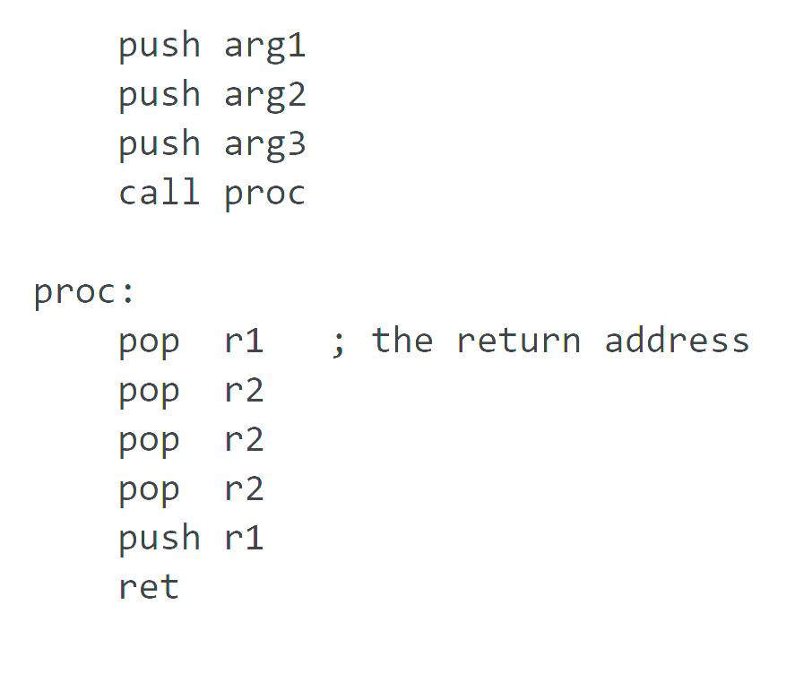
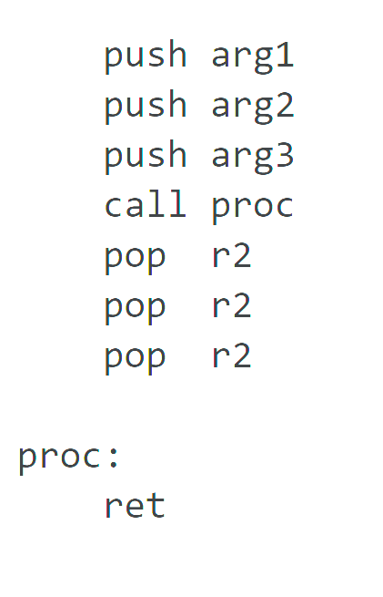
Seth’s Notes
Visualizing caller v callee cleanup
stdcall (callee) cdecl (caller)

Slide 8
EBP and ESP
EBP
Stack Base Pointer
Where the stack was when the routine started
ESP
Stack Pointer
Top of the current stack
EBP is a previous function’s saved ESP

Slide 9
cdecl – default for Linux & gcc
…
b
a
return addr
caller’s ebp
callee-save
locals (buf, c, d ≥ 28 bytes if stored on stack)
caller-save
buf
c
return addr
orange’s ebp
…
int orange(int a, int b)
{
char buf[16];
int c, d;
if(a > b) c = a;
else c = b;
d = red(c, buf);
return d;
}
parameter area (caller)
orange’s initial stack frame
%ebp
frame
%esp stack
to be created before calling red
grow
after red has been called

Slide 10
What are Buffer Overflows?
A buffer overflow occurs when data is written outside of the space allocated for the buffer.
C does not check that writes are in-bound
Stack-based
covered in this class
Heap-based
more advanced
very dependent on system and library version
Notes:
The key here is predetermined allocation.

Slide 11
Basic Example
#include <string.h>
int main(int argc, char **argv) {
char buf[64];
strcpy(buf, argv[1]);
}
Dump of assembler code for function main:
0x080483e4 <+0>: push %ebp
0x080483e5 <+1>: mov %esp,%ebp
0x080483e7 <+3>: sub $72,%esp
0x080483ea <+6>: mov 12(%ebp),%eax
0x080483ed <+9>: mov 4(%eax),%eax
0x080483f0 <+12>: mov %eax,4(%esp)
0x080483f4 <+16>: lea -64(%ebp),%eax
0x080483f7 <+19>: mov %eax,(%esp)
0x080483fa <+22>: call 0x8048300 <strcpy@plt>
0x080483ff <+27>: leave
0x08048400 <+28>: ret
…
argv
argc
return addr
caller’s ebp
buf (64 bytes)
argv[1]
buf
%ebp
%esp
11

Slide 12
“123456”
#include <string.h>
int main(int argc, char **argv) {
char buf[64];
strcpy(buf, argv[1]);
}
Dump of assembler code for function main:
0x080483e4 <+0>: push %ebp
0x080483e5 <+1>: mov %esp,%ebp
0x080483e7 <+3>: sub $72,%esp
0x080483ea <+6>: mov 12(%ebp),%eax
0x080483ed <+9>: mov 4(%eax),%eax
0x080483f0 <+12>: mov %eax,4(%esp)
0x080483f4 <+16>: lea -64(%ebp),%eax
0x080483f7 <+19>: mov %eax,(%esp)
0x080483fa <+22>: call 0x8048300 <strcpy@plt>
0x080483ff <+27>: leave
0x08048400 <+28>: ret
…
argv
argc
return addr
caller’s ebp
buf (64 bytes)
argv[1]
buf
return addr
caller’s ebp
123456\0
%ebp
%esp
12

Slide 13
“A”x68 . “\xEF\xBE\xAD\xDE”
#include <string.h>
int main(int argc, char **argv) {
char buf[64];
strcpy(buf, argv[1]);
}
Dump of assembler code for function main:
0x080483e4 <+0>: push %ebp
0x080483e5 <+1>: mov %esp,%ebp
0x080483e7 <+3>: sub $72,%esp
0x080483ea <+6>: mov 12(%ebp),%eax
0x080483ed <+9>: mov 4(%eax),%eax
0x080483f0 <+12>: mov %eax,4(%esp)
0x080483f4 <+16>: lea -64(%ebp),%eax
0x080483f7 <+19>: mov %eax,(%esp)
0x080483fa <+22>: call 0x8048300 <strcpy@plt>
0x080483ff <+27>: leave
0x08048400 <+28>: ret
…
argv
argc
return addr
caller’s ebp
buf (64 bytes)
argv[1]
buf
0xDEADBEEF
AAAA
AAAA… (64 in total)
corrupted
overwritten
overwritten
%ebp
%esp
13
Notes:
lowest byte of argc is 0; in little endian, that’s the least significant byte

Slide 14
Frame teardown—1
#include <string.h>
int main(int argc, char **argv) {
char buf[64];
strcpy(buf, argv[1]);
}
Dump of assembler code for function main:
0x080483e4 <+0>: push %ebp
0x080483e5 <+1>: mov %esp,%ebp
0x080483e7 <+3>: sub $72,%esp
0x080483ea <+6>: mov 12(%ebp),%eax
0x080483ed <+9>: mov 4(%eax),%eax
0x080483f0 <+12>: mov %eax,4(%esp)
0x080483f4 <+16>: lea -64(%ebp),%eax
0x080483f7 <+19>: mov %eax,(%esp)
0x080483fa <+22>: call 0x8048300 <strcpy@plt>
=> 0x080483ff <+27>: leave
0x08048400 <+28>: ret
…
argv
argc
0xDEADBEEF
AAAA
corrupted
overwritten
overwritten
%esp
and
%ebp
leave
mov %ebp,%esp
pop %ebp
%esp
14
Notes:
*argc is corrupted because of the null terminator

Slide 15
Frame teardown—2
#include <string.h>
int main(int argc, char **argv) {
char buf[64];
strcpy(buf, argv[1]);
}
Dump of assembler code for function main:
0x080483e4 <+0>: push %ebp
0x080483e5 <+1>: mov %esp,%ebp
0x080483e7 <+3>: sub $72,%esp
0x080483ea <+6>: mov 12(%ebp),%eax
0x080483ed <+9>: mov 4(%eax),%eax
0x080483f0 <+12>: mov %eax,4(%esp)
0x080483f4 <+16>: lea -64(%ebp),%eax
0x080483f7 <+19>: mov %eax,(%esp)
0x080483fa <+22>: call 0x8048300 <strcpy@plt>
0x080483ff <+27>: leave
0x08048400 <+28>: ret
…
argv
argc
0xDEADBEEF
corrupted
overwritten
%esp
%ebp = AAAA
leave
mov %ebp,%esp
pop %ebp
15
Notes:
What to put at 0xDEADBEEF? Or rather, what should we put?

Slide 16
Frame teardown—3
#include <string.h>
int main(int argc, char **argv) {
char buf[64];
strcpy(buf, argv[1]);
}
Dump of assembler code for function main:
0x080483e4 <+0>: push %ebp
0x080483e5 <+1>: mov %esp,%ebp
0x080483e7 <+3>: sub $72,%esp
0x080483ea <+6>: mov 12(%ebp),%eax
0x080483ed <+9>: mov 4(%eax),%eax
0x080483f0 <+12>: mov %eax,4(%esp)
0x080483f4 <+16>: lea -64(%ebp),%eax
0x080483f7 <+19>: mov %eax,(%esp)
0x080483fa <+22>: call 0x8048300 <strcpy@plt>
0x080483ff <+27>: leave
0x08048400 <+28>: ret
…
argv
argc
corrupted
%esp
%eip = 0xDEADBEEF
(probably crash)
16
Notes:
What to put at 0xDEADBEEF? Or rather, what should we put?

Slide 17
Shellcode
…
0x080483fa <+22>: call 0x8048300 <strcpy@plt>
0x080483ff <+27>: leave
0x08048400 <+28>: ret
…
argv
argc
&buf
…
shellcode…
argv[1]
buf
Traditionally, we inject assembly instructions for exec(“/bin/sh”) into buffer.
see “Smashing the stack for fun and profit” for exact string
or search online
%ebp
%esp

Slide 18
Recap
To generate exploit for a basic buffer overflow:
Determine size of stack frame up to head of buffer
Overflow buffer with the right size
computation + control
shellcode | padding | &buf

Slide 19
Dealing With Control Flow Violations
Make it harder to control a subverted flow
Make taking control of the flow innocuous
Make it harder to get control of the flow

Slide 20
Disrupting Exploitative Operations
Random Stack Gap
ASLR, PIE, etc

Slide 21
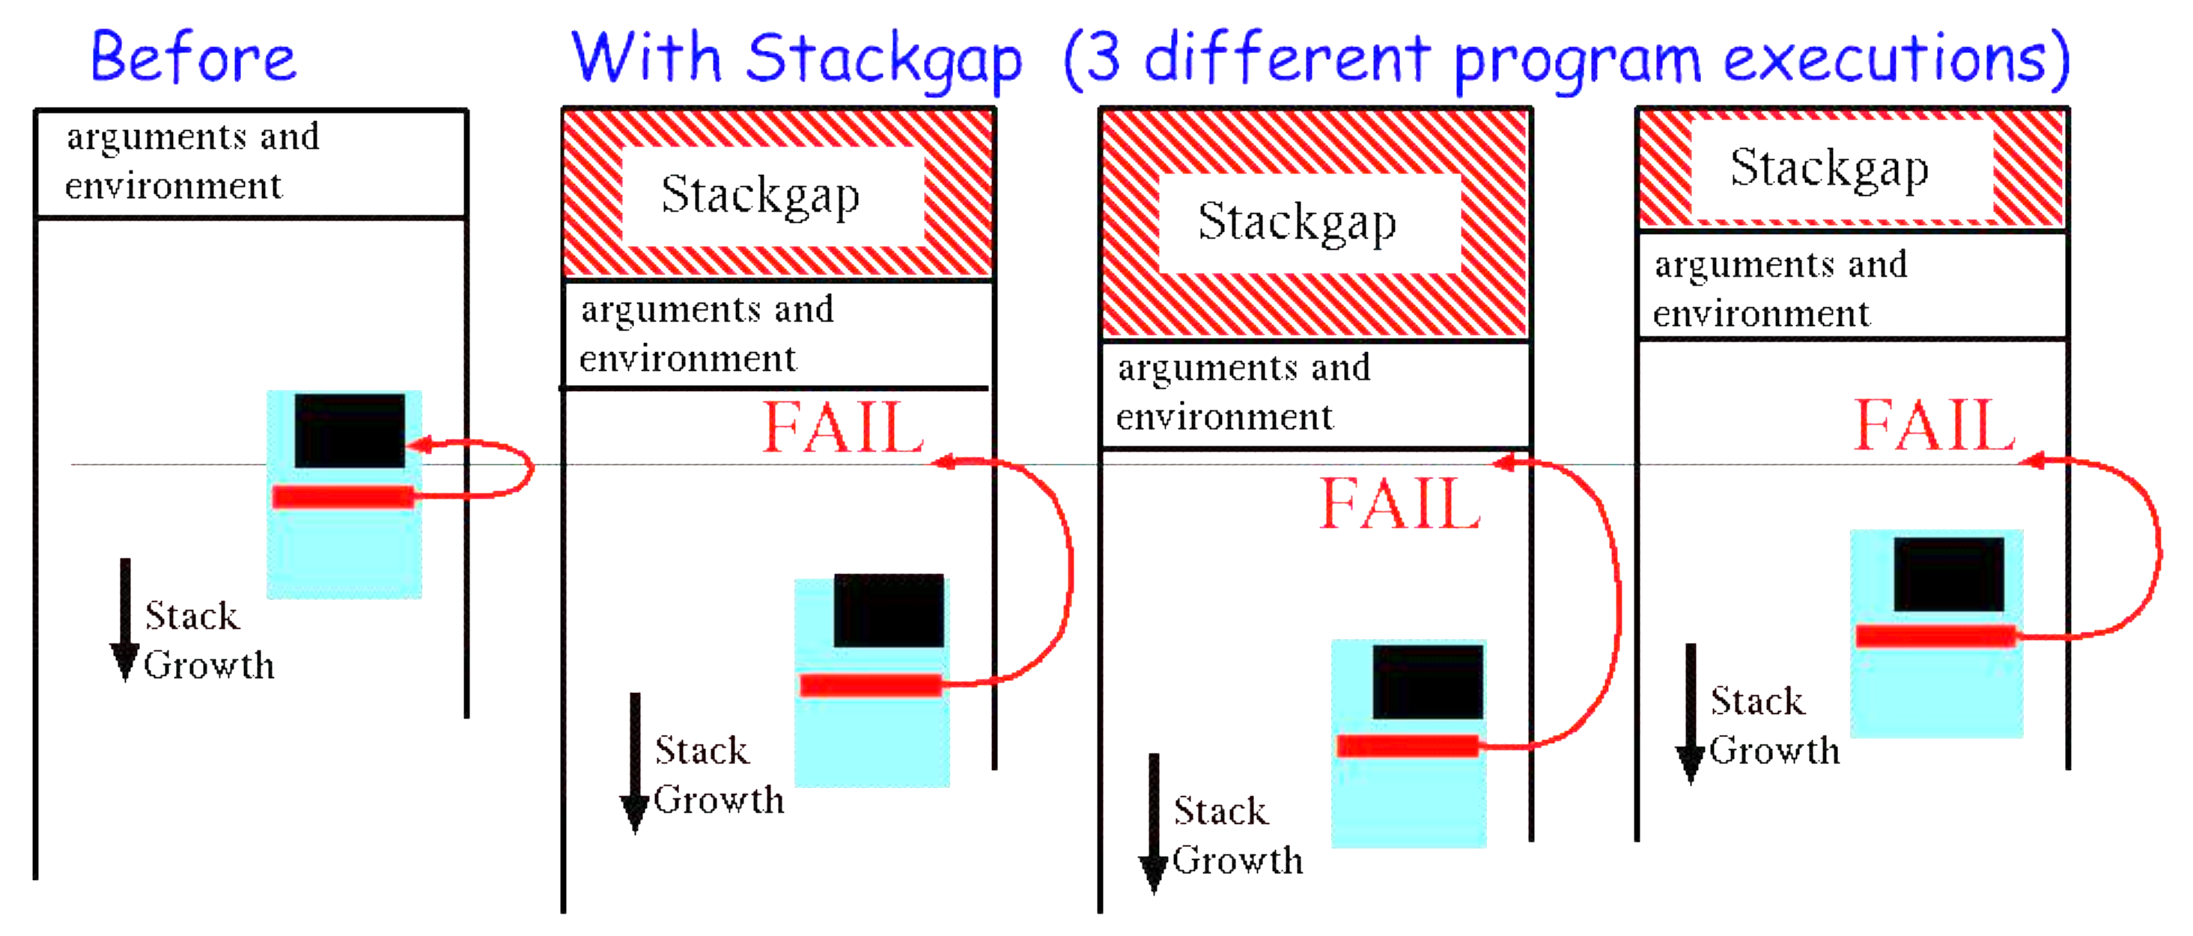
Random Stack Gap

Slide 22
ASLR
Address Space Layout Randomization
Subversion usually needs to know memory layout
General goal: make layout unpredictable

Slide 23
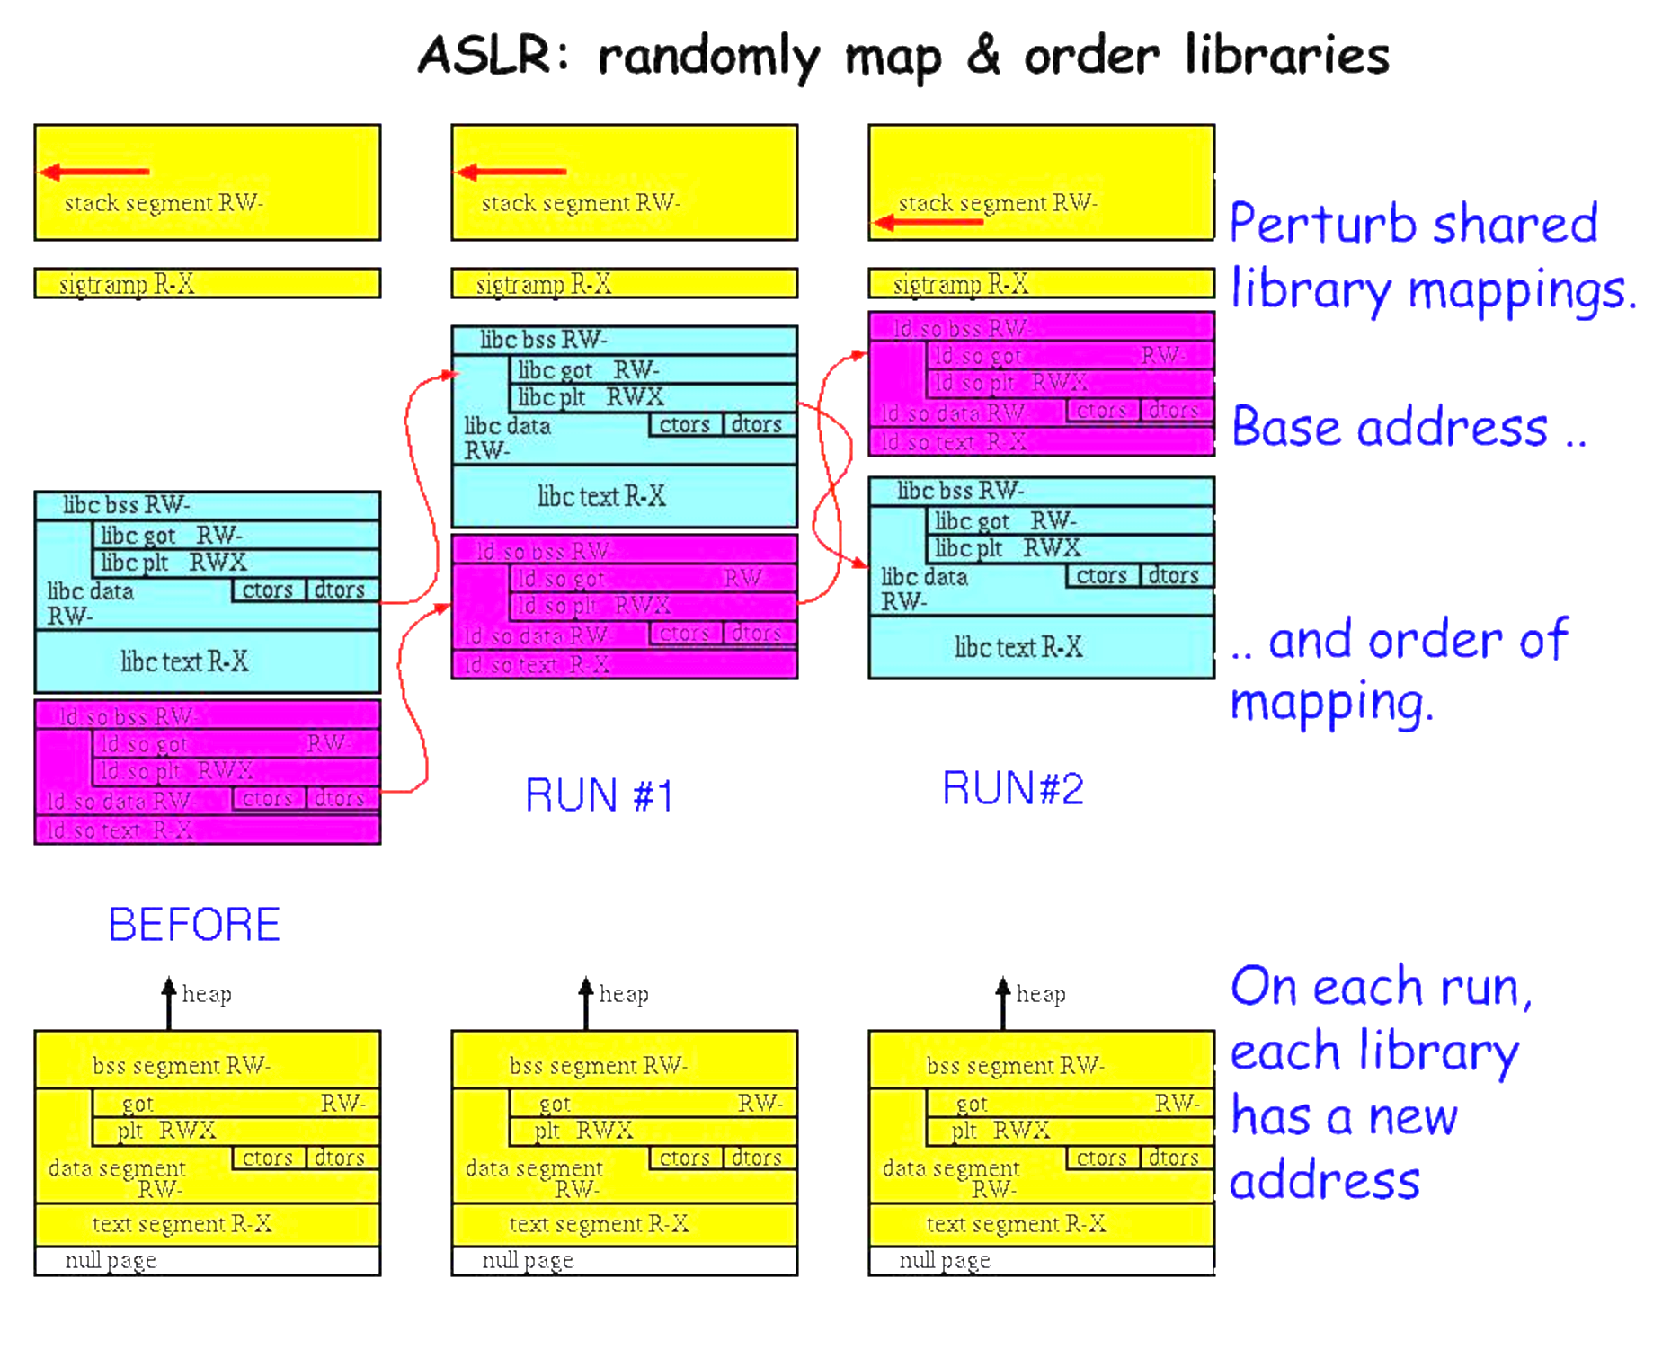
Start With Libraries

Slide 24
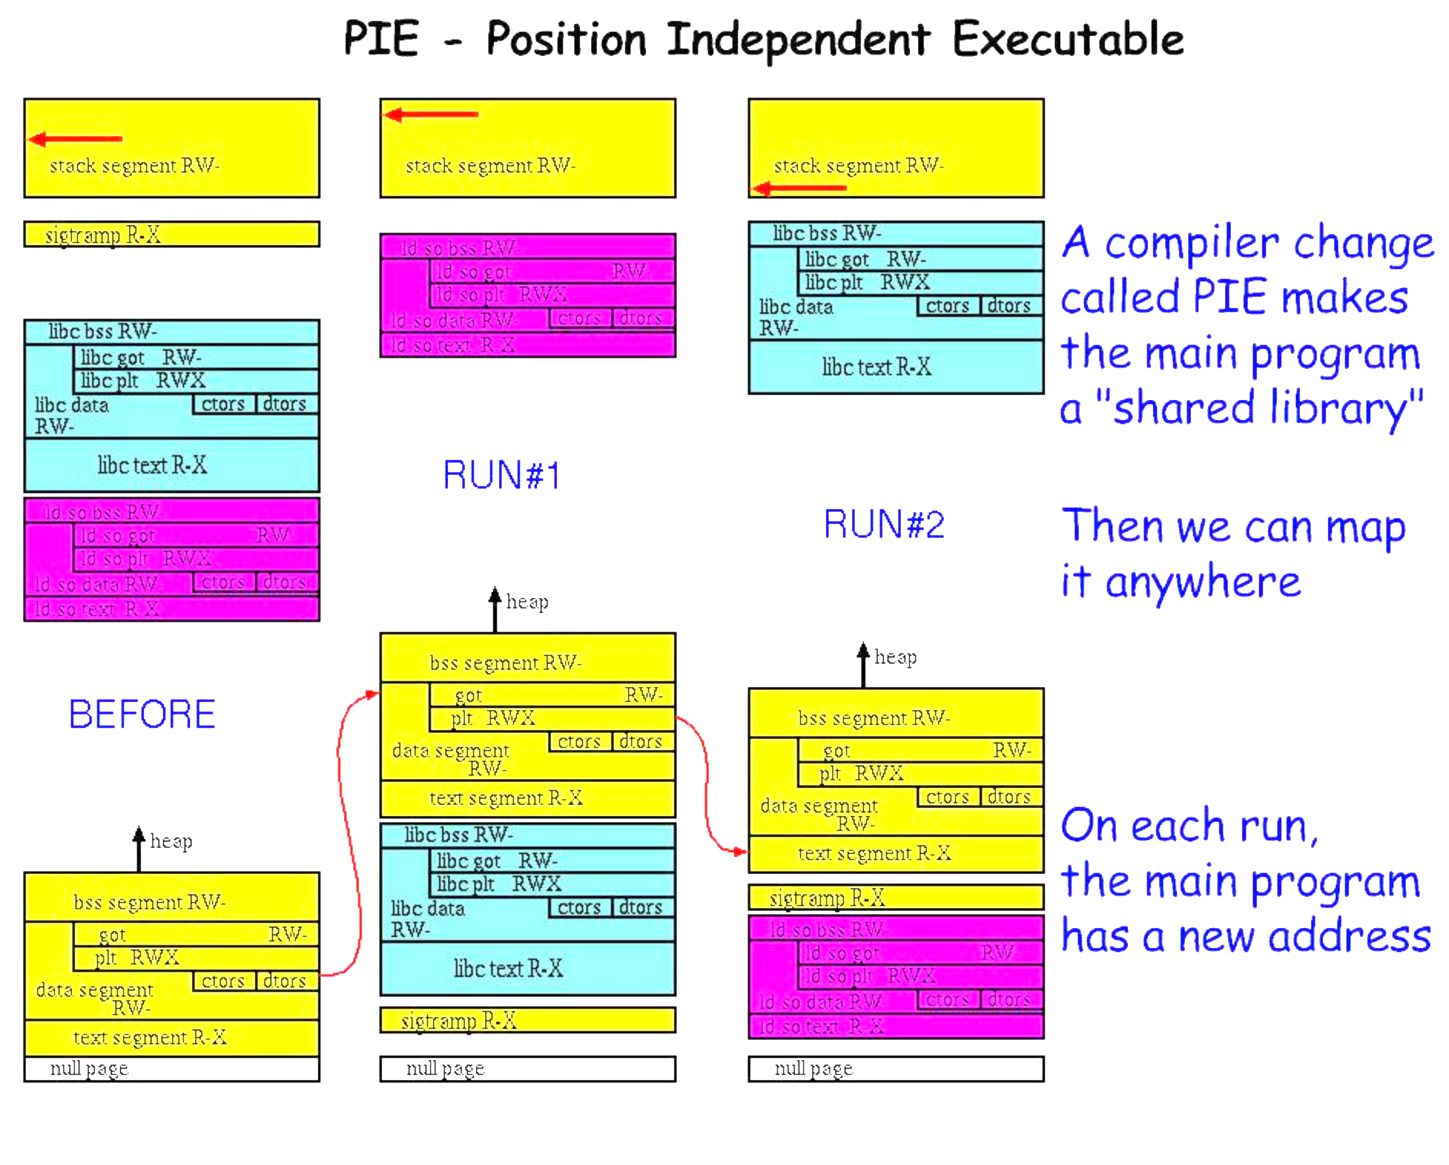
Add Executables

Slide 25
Finally, Dynamic Allocations
mmap
malloc

Slide 26
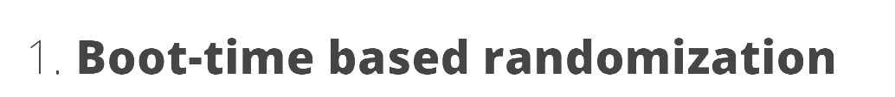






Limitations of ASLR

Slide 27
Making Violations Less Dangerous
W^X Permissions
rodata

Slide 28
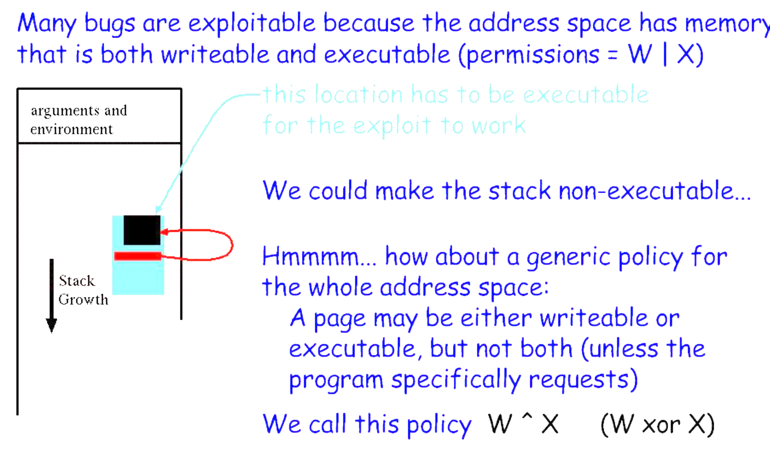
W|x Permissions

Slide 29
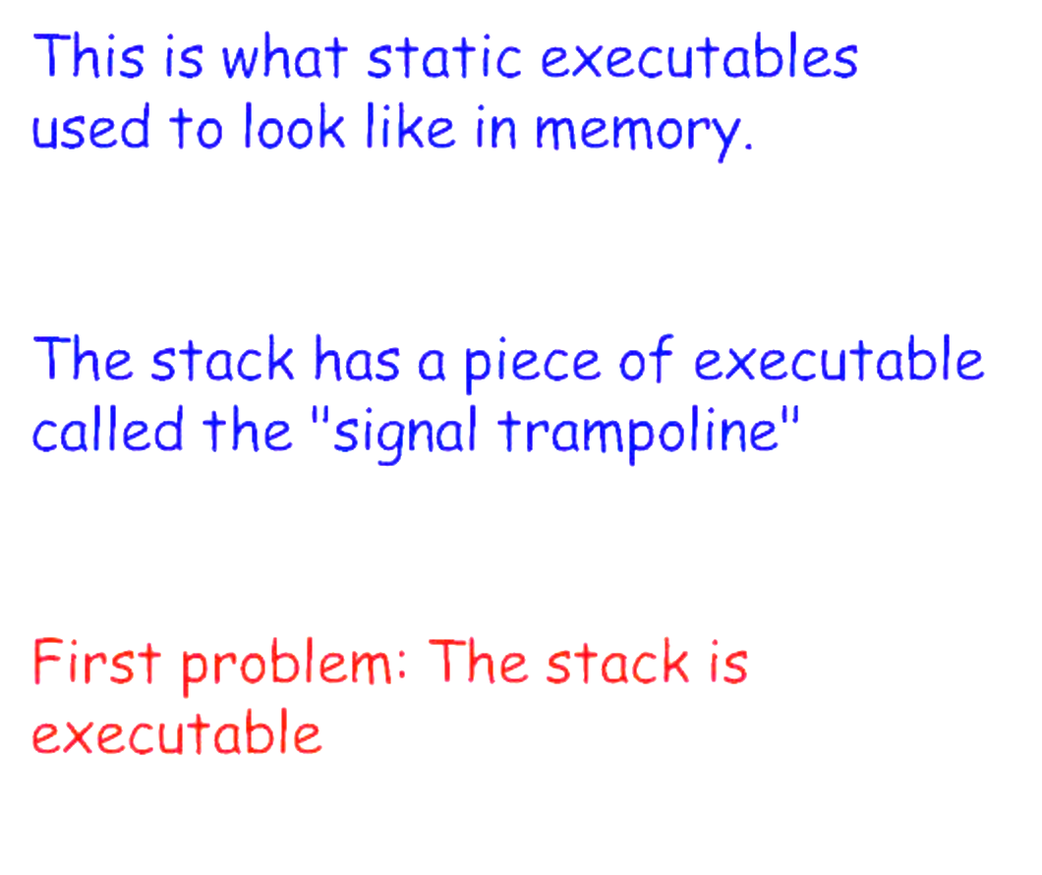
Executable Stacks
What is this?

Slide 30
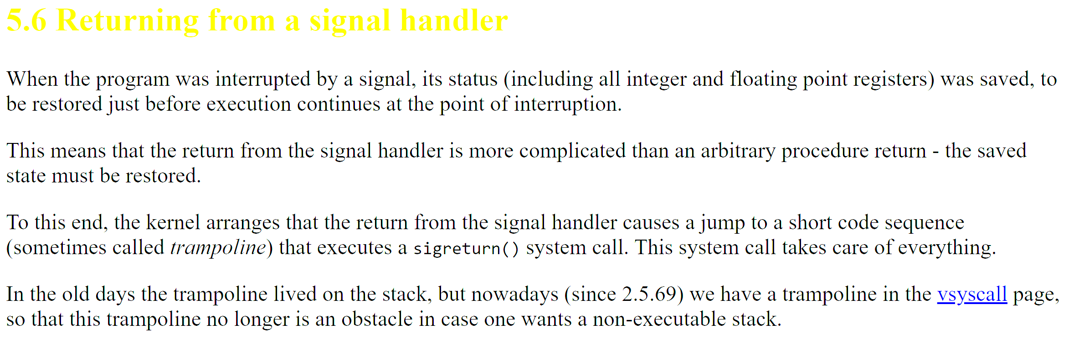
Linux Trampoline?

Slide 31
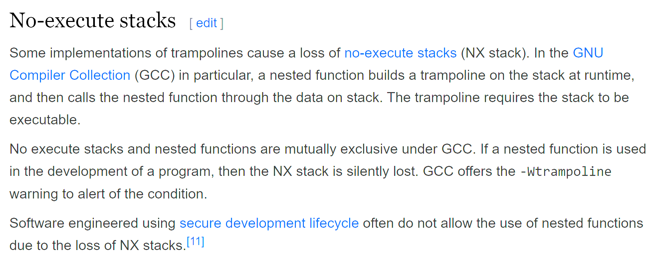

Linux Trampoline!!!

Slide 32
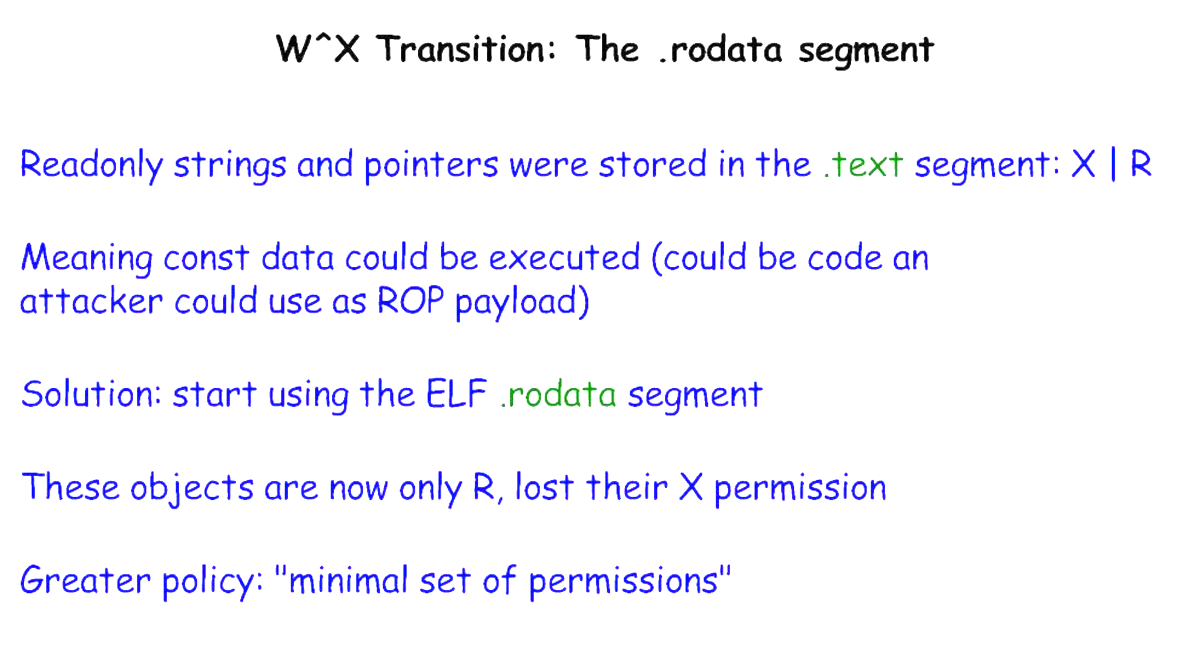
The .rodata Segment

Slide 33
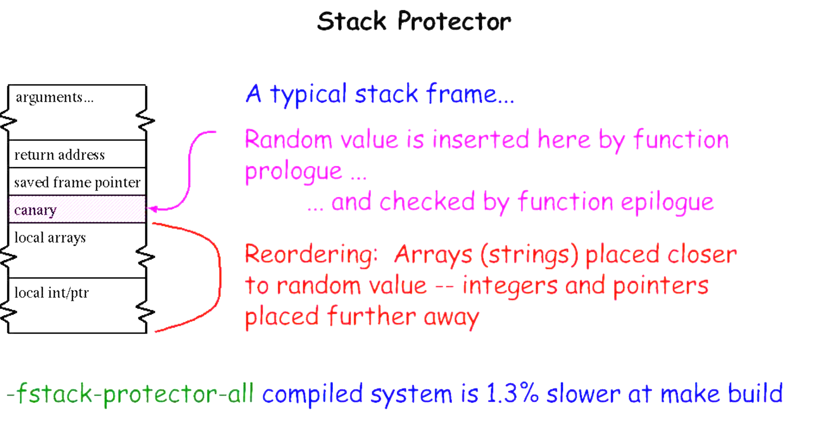
Finally, Blocking Exploits

Slide 34

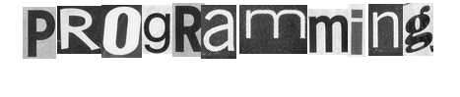
David Brumley
Carnegie Mellon University
Credit: Some slides from Ed Schwartz

Slide 35
Control Flow Hijack: Always control + computation
shellcode (aka payload) | padding | &buf
computation + control
"\x31\xc9\xf7\xe1\x51\x68\x2f\x2f”
"\x73\x68\x68\x2f\x62\x69\x6e\x89”
"\xe3\xb0\x0b\xcd\x80”;
Previously: Executable code as input

Slide 36
Control Flow Hijack: Always control + computation
shellcode (aka payload) | padding | &buf
computation + control
Today: Return Oriented Programming
Execution without injecting code

Slide 37
ROP Overview
Idea: We forge shell code out of existing application logic gadgets
Requirements: vulnerability + gadgets + some unrandomized code (we need to know the addresses of gadgets)
Technically, PREDICTABLE

Slide 38
Motivation: Return-to-libc Attack
ptr to “/bin/sh”
…
argv
argc
return addr
caller’s ebp
“/bin/sh"
argv[1]
buf
ret transfers control to system, which finds arguments on stack
&system
Overwrite return address with address of libc function
setup fake return address and argument(s)
ret will “call” libc function
No injected code!
%ebp
%esp

Slide 39
Question
Randomized!
ptr to “/bin/sh”
…
argv
argc
return addr
caller’s ebp
“/bin/sh"
argv[1]
buf
&system
%ebp
With ASLR, we cannot forge a correct value for ptr since ASLR will randomize addresses.
What can we do?
%esp

Slide 40
Computed “/bin/sh”
Writes
&system
gadgets to compute ptr to “/bin/sh”
Idea!
Get a copy of ESP to calculate address of “/bin/sh” on randomized stack.
This works because ASLR only protects against knowing absolute addresses, while we will find it’s relative address.
…
argv
argc
return addr
caller’s ebp
buf “/bin/sh”
argv[1]
buf
Notes:
Useful, for example, to get a copy of ESP. If we know relative offset of ptr to esp, we can know use that relative offset knowledge to locate a pointer.
This overcomes ASLR because ASLR only protects against knowing absolute addresses.

Slide 41
Return Chaining
Suppose we want to call 2 functions in our exploit: foo(arg1, arg2) bar(arg3, arg4)
Stack unwinds up
First function returns into code to advance stack pointer
e.g., pop; pop; ret
arg4
arg3
&(pop-pop-ret)
bar
arg2
arg1
&(pop-pop-ret)
foo
What does this do?
Overwritten ret addr
Notes:
Note that when foo runs, foo thinks &pop-pop-ret as the saved return address. It accesses arg1 and arg2.
When foo returns, it executes &pop-pop-ret to remove the arguments to foo, and then executes bar.

Slide 42
Return Chaining
When foo is executing, &pop-pop-ret is at the saved EIP slot.
When foo returns, it executes pop-pop-ret to clear up arg1 (pop), arg2 (pop), and transfer control to bar (ret)
arg4
arg3
&(pop-pop-ret)
bar
arg2
arg1
&(pop-pop-ret)
foo
Notes:
Note that when foo runs, foo thinks &pop-pop-ret as the saved return address. It accesses arg1 and arg2.
When foo returns, it executes &pop-pop-ret to remove the arguments to foo, and then executes bar.

Slide 43
There are many semantically equivalent ways to achieve the same net shellcode effect
Let’s practice thinking in gadgets

Slide 44
An example operation
...
v₂
...
v₁
Mem[v2] = v1
Desired Logic
esp
Stack
a₁: mov eax, [esp] ; eax has v1
a₂: mov ebx, [esp+8] ; ebx has v2
a₃: mov [ebx], eax ; Mem[v2] = eax
Implementation 1

Slide 45
implementing with gadgets
Suppose a₅ and a₃ on stack
a₅
v₂
a₃
v₁
Mem[v2] = v1
Desired Logic
esp
Stack
a₁: pop eax
a₂: ret
a₃: pop ebx
a₄: ret
a₅: mov [ebx], eax
eax
ebx
eip
v₁
a₁
Implementation 2

Slide 46
implementing with gadgets
a₅
v₂
a₃
v₁
Mem[v2] = v1
Desired Logic
esp
Stack
a₁: pop eax
a₂: ret
a₃: pop ebx
a₄: ret
a₅: mov [ebx], eax
eax
ebx
eip
v₁
a₁
a₃
Implementation 2

Slide 47
implementing with gadgets
a₅
v₂
a₃
v₁
Mem[v2] = v1
esp
Desired Logic
Stack
a₁: pop eax
a₂: ret
a₃: pop ebx
a₄: ret
a₅: mov [ebx], eax
eax
ebx
eip
v₁
v₂
a₃
Implementation 2

Slide 48
implementing with gadgets
a₅
v₂
a₃
v₁
esp
Mem[v2] = v1
Desired Logic
Stack
a₁: pop eax;
a₂: ret
a₃: pop ebx;
a₄: ret
a₅: mov [ebx], eax
eax
ebx
eip
v₁
v₂
a₄
a₅
Implementation 2

Slide 49
implementing with gadgets
esp
a₅
v₂
a₃
v₁
Mem[v2] = v1
Desired Logic
Stack
a₁: pop eax;
a₂: ret
a₃: pop ebx;
a₄: ret
a₅: mov [ebx], eax
Gadget 1
eax
ebx
eip
v₁
v₂
Gadget 2
a₅
Implementation 2
Notes:
Note the gadgets can be in separate locations...gadget 1 does not have to be contiguous with gadget 2.

Slide 50
Equivalence
a₃
v₂
a₂
v₁
Mem[v2] = v1
Desired Logic
semantically equivalent
esp
Stack
“Gadgets”
a₁: mov eax, [esp]
a₂: mov ebx, [esp+8]
a₃: mov [ebx], eax
a₁: pop eax; ret
a₂: pop ebx; ret
a₃: mov [ebx], eax
Implementation 1
Implementation 2

Slide 51
Return-Oriented Programming (ROP)
…
argv
argc
return addr
caller’s ebp
buf (64 bytes)
argv[1]
buf
Mem[v2] = v1
Desired Shellcode
%ebp
Find needed instruction gadgets at addresses a₁, a₂, and a₃ in existing code
Overwrite stack to execute a₁, a₂, and then a₃
%esp

Slide 52
Return-Oriented Programming (ROP)
a₃
v₂
a₂
v₁
a₁
…
argv
argc
return addr
caller’s ebp
buf (64 bytes)
argv[1]
buf
Mem[v2] = v1
Desired Shellcode
%ebp
a₁: pop eax; ret
a₂: pop ebx; ret
a₃: mov [ebx], eax
Desired store executed!
%esp

Slide 53
Equivalence
a₃
v₂
a₂
v₁
Mem[v2] = v1
Desired Logic
Address independent!
Stack
a₁: pop eax; ret
...
a₃: mov [ebx], eax ...
a₂: pop ebx; ret
a₁: pop eax; ret
a₂: pop ebx; ret
a₃: mov [ebx], eax
Implementation 2

Slide 54
Gadgets
A gadget is a set of instructions for carrying out a semantic action
mov, add, etc.
Gadgets typically have a number of instructions
One instruction = native instruction set
More instructions = synthesize <- ROP
Gadgets in ROP generally (but not always) end in return

Slide 55
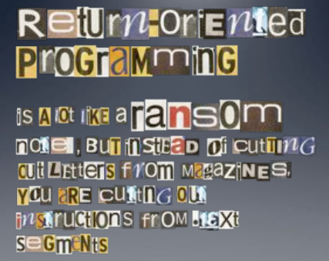
Image by Dino Dai Zovi

Slide 56
RO(P?) Programming
Disassemble code
Identify useful code sequences as gadgets
Assemble gadgets into desired shellcode

